Slide 1
Programming fundamentals
Section 8

Slide 2
Example
Write a c++ program to calculate Sum=1!+2!+3!+4!+5! By using function .
#include<iostream> using namespace std; int factorial(); void main() { int sum = 0, i; cout << "sum of 1!+2!+3!+4!+5! = " << factorial() << endl; system("Pause"); } | int factorial() { int i,j, fact,sum=0; for (i = 1; i <= 5;i++) { fact = 1; for (j = i; j >= 1; j--) { fact *= j; } sum += fact; } return sum; }

Slide 3
Example (Show output)
#include <iostream> using namespace std; void main() {int high = 20; int low = 0; while (low < high) { low = low + 3; high = high – 2; } cout << "Low: " << low << " High: " << high << endl; system("Pause");}

Slide 4
call by reference
The call by reference method of passing arguments to a function copies the reference of an argument into the formal parameter. Inside the function, the reference is used to access the actual argument used in the call. This means that changes made to the parameter affect the passed argument.

Slide 5
Swap 2 values
#include <iostream> using namespace std; void swap(int &x, int &y); void main() { int a, b; cout << "enter 2 values: "; cin >> a >> b; cout << "Before swap, value of a :" << a << endl; cout << "Before swap, value of b :" << b << endl; swap(a, b); | cout << "After swap, value of a :" << a << endl; cout << "After swap, value of b :" << b << endl; system("Pause"); } void swap(int &x, int &y) { int temp; temp = x; x = y; y = temp; }

Slide 6
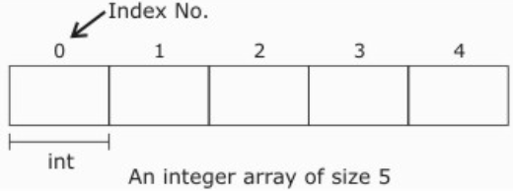
Array
An array is a collection of data elements of same data type. It is described by a single name and each element of an array is referenced by using array name and its subscript no (index) .
Declaration of Array
Type arrayName [numberOfElements] ;
int salary[5] ; float Degree[30];

Slide 7
Array
Initialization of One Dimensional Array
An array can be initialized along with declaration. For array initialization it is required to place the elements separated by commas enclosed within braces.
int A[5] = {11,2,23,4,15};
It is possible to leave the array size open. The compiler will count the array size.
int B[] = {6,7,8,9,15,12};

Slide 8
Referring to Array Elements
we can access the value of any of its elements individually as if it was a normal variable, thus being able to both read and modify its value. The format is as simple as:
name[index]
cout<<salary[4]; //print an array element
salary[4]=80; // assign value to an array element
cin>>age[4]; //input element 5

Slide 9
Example
#include<iostream> using namespace std; void main() { float arr[5]; cout << "enter the degree of 5 subjects"; int count = 0; while (count < 5) { cin >> arr[count]; | count++; } cout << "your degrees are: "<<endl; count = 0; while (count < 5) { cout << arr[count]<<endl; count++; } system("Pause"); }

